Slide 2
Controller design and tuning: Region 2.5 and 3
Wind Turbine Control Online Course
Alan Wai Hou Lio
Researcher, DTU Wind Energy
wali@dtu.dk

Slide 3
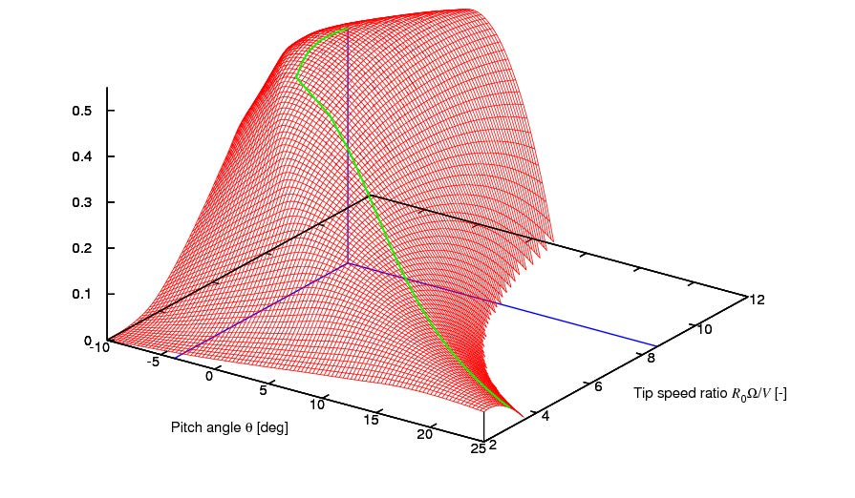
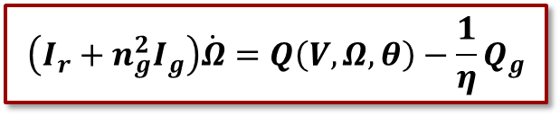
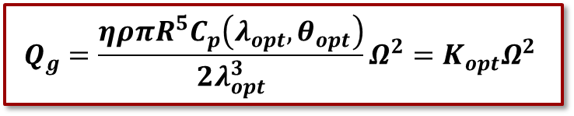



Re-cap
Region 2.5
Region 3
Region 2
Three operational regions.
Region 2 Controller:
Transient analysis:
$$Q_{g}=\frac{ηρπR^{5}C_{p}\left(λ_{opt},θ_{opt}\right)}{2λ_{opt}^{3}}Ω^{2}=K_{opt}Ω^{2}$$
Region 2
Region 2.5
$${θ=θ}_{opt}$$
Cp
Region 3
$$\left(I_{r}+n_{g}^{2}I_{g}\right)\dot{Ω}=Q\left(V,Ω,θ\right)−\frac{1}{η}Q_{g}$$
$$λ_{opt}$$
$$θ_{opt}$$

Slide 4
Reading materials
https://github.com/alanliowh/Control_Online_Course
Updated files
https://github.com/alanliowh/Control_Online_Course

Slide 5
Learning objectives
After this session you should be able to:
Describe what types of controllers are used in Region 2.5 and 3.
Tune a PI pitch and torque controller in Region 2.5 and 3
Calculate aerodynamic gain scheduling for Region 3

Slide 6
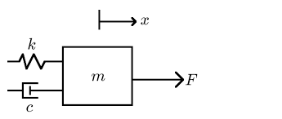




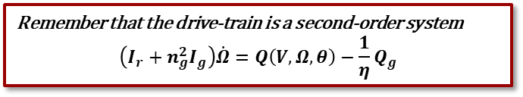

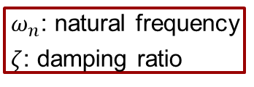


Second-order mass-spring-damper system
Newton’s second law
Consider a mass-spring-damper system:
Standard form:
Solution of the second-order system
$m\ddot{x}+c\dot{x}+kx=F$
$ω_{n}$: natural frequency
$ζ$: damping ratio
$$x\left(t\right)=Ae^{\left(−ζω_{n}±jω_{n}\sqrt{{1−ζ}^{2} }\right)t}$$
$$ζ=0.2$$
$$ω_{n}=0.05×2π$$
$$ω_{n}\sqrt{1−ζ^{2} }$$
Remember that the drive-train is a second-order system $$\left(I_{r}+n_{g}^{2}I_{g}\right)\dot{Ω}=Q\left(V,Ω,θ\right)−\frac{1}{η}Q_{g}$$
Damped natural frequency

Slide 7
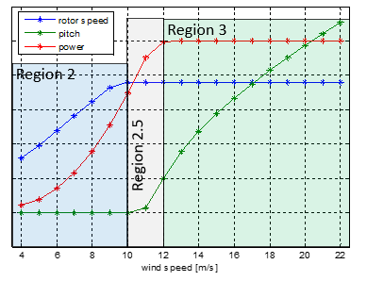
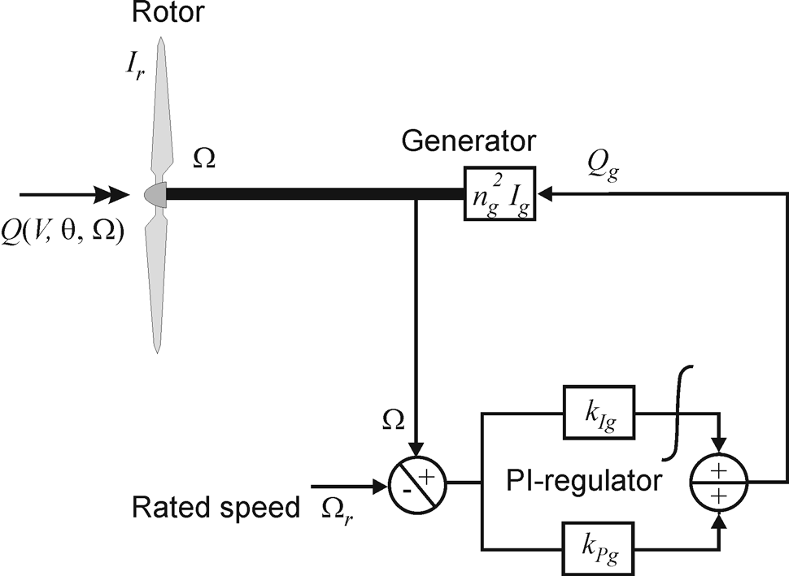
Region 2.5: Speed regulation
Strategy: Use generator torque (and pitch) to regulate rotor speed to the rated speed

Slide 8


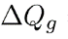
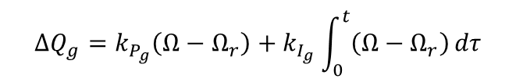

Region 2.5: Speed regulation
Lecture notes
Nonlinear equation of motion of drivetrain dynamic:
Generator torque behaves like a PI controller:
Pitch controller also behaves like a PI controller
Since it’s the same in Region 3, let’s discuss later
For simplicity, in the analysis we assume $θ=θ_{opt}$
Now, we need to tune Kp and Ki
Control input
$$ΔQ_{g}=k_{P_{g}}\left(Ω−Ω_{r}\right)+k_{I_{g}}\int_{0}^{t}{\left(Ω−Ω_{r}\right)}dτ$$
+

Slide 9


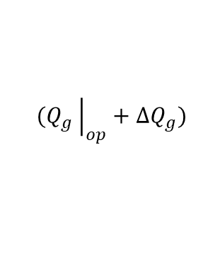
Region 2.5: Linearisation
Consider the drive-train equation
Let’s linearise it, and define the operating point and deviations
Substituting the derivations into the drive-train equation
Thus, the linearised equation becomes:
$$(Q_{g}{\left.​\right|}_{op}+ΔQ_{g})$$
Taylor series expansion
$Q\left(V_{op}+Δv,Ω_{r}+\dot{φ},θ_{op}+Δθ\right)=Q\left(V_{op},Ω_{r},θ_{op}\right)+\frac{∂Q}{∂V}Δv+\frac{∂Q}{∂Ω}\dot{φ}+\frac{∂Q}{∂θ}Δθ+$…
From previous slide
$${ΔQ}_{g}=k_{P_{g}}\dot{φ}+k_{I_{g}}φ$$
$\left(I_{r}+n_{g}^{2}I_{g}\right)\ddot{φ}=\frac{∂Q}{∂V}Δv+\frac{∂Q}{∂Ω}\dot{φ}+\frac{∂Q}{∂θ}Δθ−\frac{1}{η}(k_{P_{g}}\dot{φ}+k_{I_{g}}φ$)

Slide 10
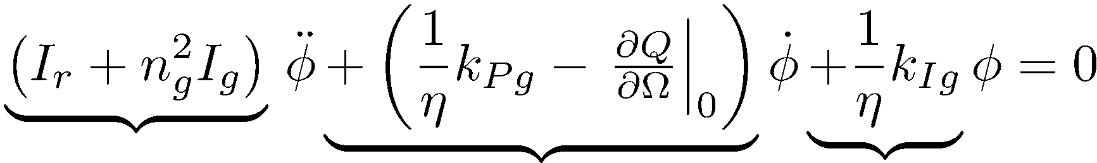

Region 2.5: Analysis
Linearised equation of drive-train
Closed-loop equation as second-order system
$\left(I_{r}+n_{g}^{2}I_{g}\right)\ddot{φ}=\frac{dQ}{dV}Δv+\frac{dQ}{dΩ}\dot{φ}+\frac{dQ}{dθ}Δθ−\frac{1}{η}(K_{P_{g}}\dot{φ}+K_{I_{g}}φ$)
$$\frac{∂Q}{∂θ}Δθ+\frac{∂Q}{∂V}Δv$$
External force
mass
damping
stiffness

Slide 11
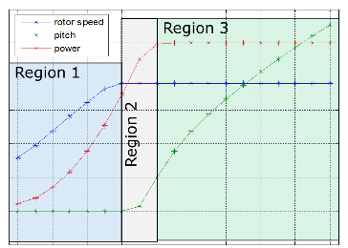
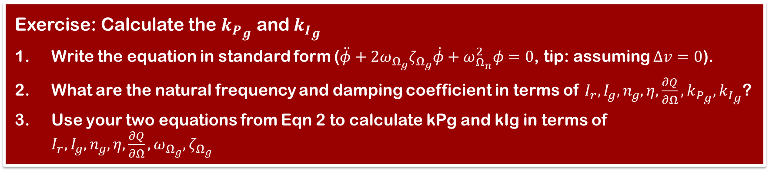
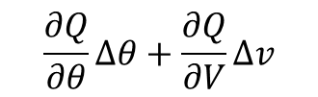
Region 2: Speed regulation
The linearized closed-loop controller equation
$$\frac{∂Q}{∂θ}Δθ+\frac{∂Q}{∂V}Δv$$
External force
mass
damping
stiffness
Exercise: Calculate the ${k_{P}}_{g}$ and ${k_{I}}_{g}$
Write the equation in standard form ($\ddot{φ}+2ω_{Ω_{g}}ζ_{Ω_{g}}\dot{φ}+ω_{Ω_{n}}^{2}φ=0$, tip: assuming $Δv=0$).
What are the natural frequency and damping coefficient in terms of $I_{r},I_{g}, n_{g},η,\frac{∂Q}{∂Ω},{k_{P}}_{g},{k_{I}}_{g}$?
Use your two equations from Eqn 2 to calculate kPg and kIg in terms of $I_{r},I_{g}, n_{g},η,\frac{∂Q}{∂Ω},ω_{Ω_{g}},ζ_{Ω_{g}}$

Slide 12
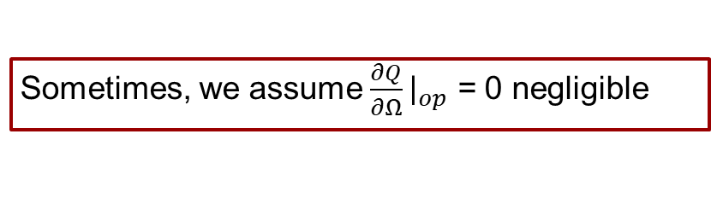
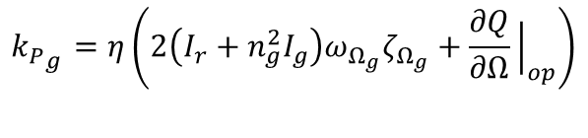
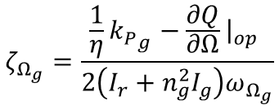
Region 2.5: Exercise answer
$${k_{P}}_{g}=η\left(2\left(I_{r}+n_{g}^{2}I_{g}\right)ω_{Ω_{g}}ζ_{Ω_{g}}+\frac{∂Q}{∂Ω}{\left.​\right|}_{op}\right)$$
$$ζ_{Ω_{g}}=\frac{\frac{1}{η}{k_{P}}_{g}−\frac{∂Q}{∂Ω}{\left.​\right|}_{op} }{2\left(I_{r}+n_{g}^{2}I_{g}\right)ω_{Ω_{g}}}$$
Sometimes, we assume $\frac{∂Q}{∂Ω}{\left.​\right|}_{op}$ = 0 negligible

Slide 13
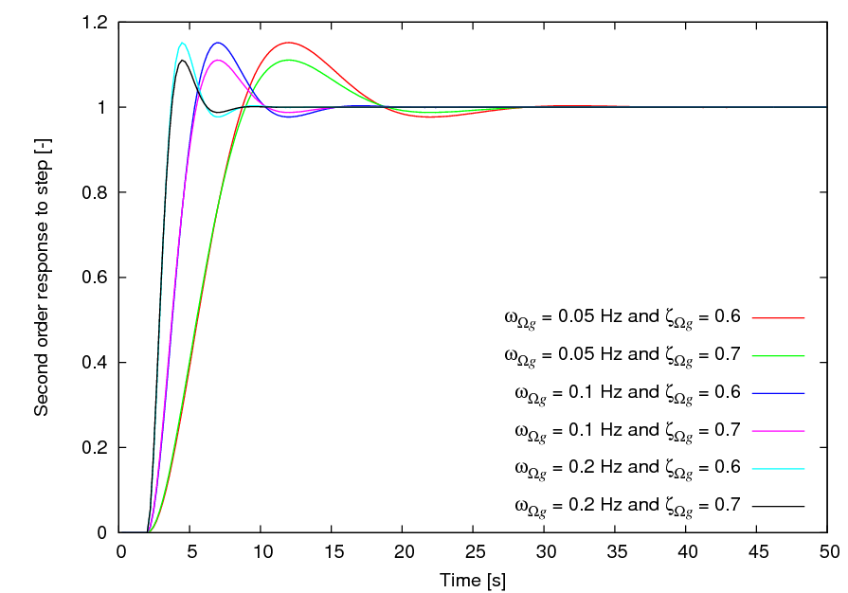
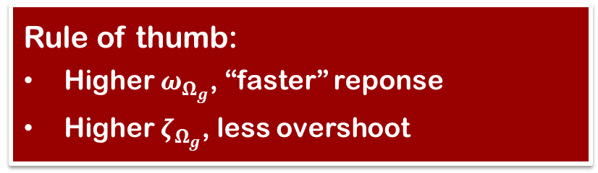
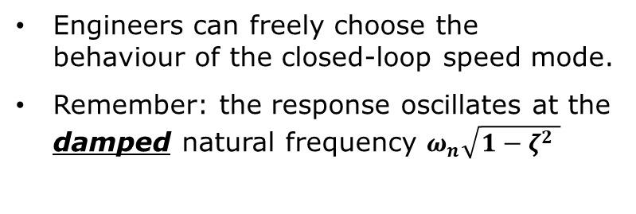
Region 2.5: Pole-placement
Engineers can freely choose the behaviour of the closed-loop speed mode.
Remember: the response oscillates at the damped natural frequency $ω_{n}\sqrt{{1−ζ}^{2} }$
Rule of thumb:
Higher $ω_{Ω_{g}}$, “faster” reponse
Higher $ζ_{Ω_{g}}$, less overshoot

Slide 14
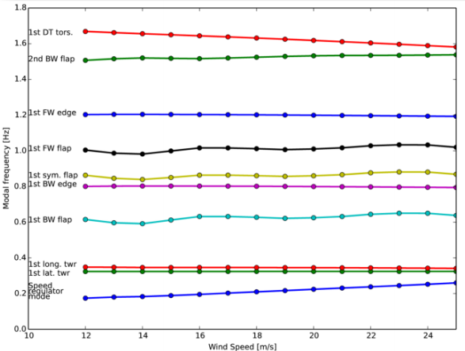


Region 2.5: Pole-placement
$$ω_{n}\sqrt{{1−ζ}^{2} }$$
Damped natural frequency
Speed regulator mode frequency should be :
Not too low to avoid large rotor speed oscillation
Not too high to avoid tower excitation
$$\frac{∂Q}{∂θ}Δθ+\frac{∂Q}{∂V}Δv$$
External force
mass
damping
stiffness

Slide 15
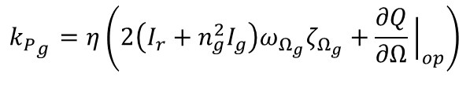
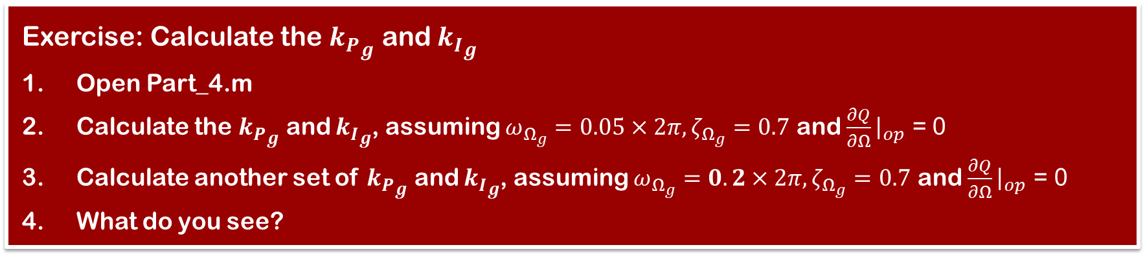
Region 2.5 : Exercise
$${k_{P}}_{g}=η\left(2\left(I_{r}+n_{g}^{2}I_{g}\right)ω_{Ω_{g}}ζ_{Ω_{g}}+\frac{∂Q}{∂Ω}{\left.​\right|}_{op}\right)$$
DTU 10MW
tower natural frequency = 0.25 Hz (turbine.omega_t in rad/s)
turbine.J= 0.1570966689E+09;
turbine.neff = 0.94;
Exercise: Calculate the ${k_{P}}_{g}$ and ${k_{I}}_{g}$
Open Part_4.m
Calculate the ${k_{P}}_{g}$ and ${k_{I}}_{g}$, assuming $ω_{Ω_{g}}=0.05×2π,ζ_{Ω_{g}}=0.7$ and $\frac{∂Q}{∂Ω}{\left.​\right|}_{op}$ = 0
Calculate another set of ${k_{P}}_{g}$ and ${k_{I}}_{g}$, assuming $ω_{Ω_{g}}=0.2×2π,ζ_{Ω_{g}}=0.7$ and $\frac{∂Q}{∂Ω}{\left.​\right|}_{op}$ = 0
What do you see?

Slide 16
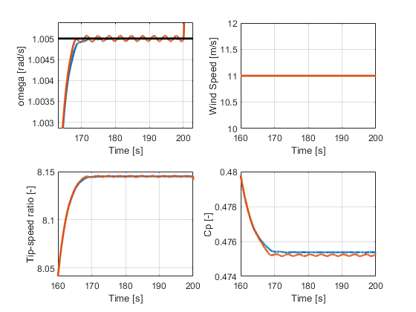
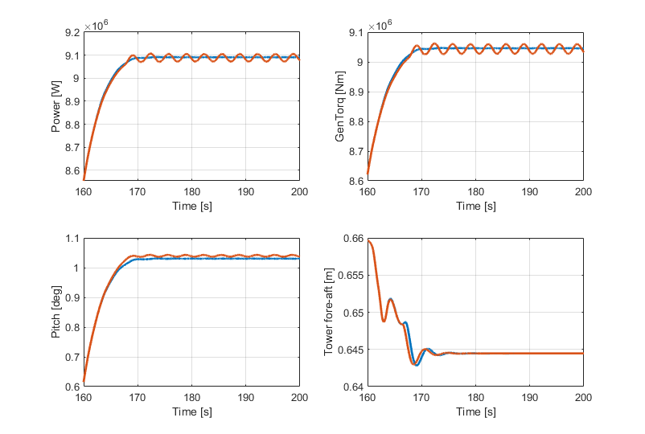
Region 2.5: Answer
controller.Kp25 = 6.4949e7 ;
controller.Ki25 = 1.4575e7;
controller.Kp25 = 2.598e8 ;
controller.Ki25 = 2.33e8;

Slide 17
Tower frequency
How can the tower frequency affect the system?
Tower fore-aft acceleration
Tower
Tower fore-aft velocity
Relative wind
Thrust
Wind
Rotor
Pitch, Qg
Omega, Power
Controller

Slide 18
Region 2.5: Summary
Generator speed is regulated using a PI controller on the generator torque (Kpg, Kig)

Slide 19
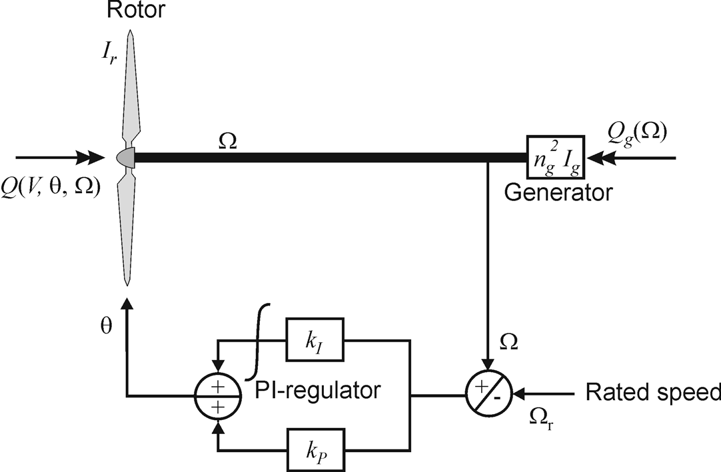
Region 3: Power and speed regulation
Strategy: Regulate rotor speed by pitching and use generator torque to regulate power (either as constant power, or constant torque)

Slide 20
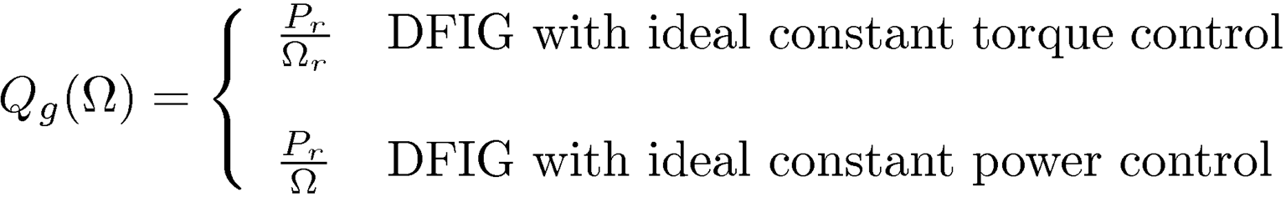
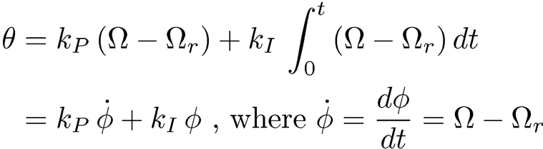
Region 3: Power and speed regulation
Nonlinear equation of drivetrain motion
Generator model
PI feedback from speed error to pitch angle
Δ

Slide 21


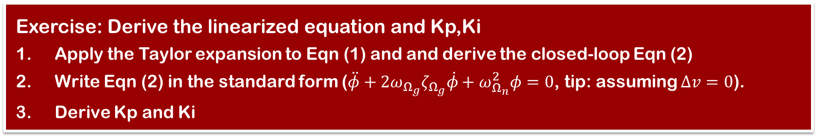
Region 3: Power and speed regulation
Nonlinear drive-train equation
Linear closed-loop equation for small drivetrain motion about $Ω=Ω_{r}+\dot{φ}$
(1)
$$\frac{∂Q}{∂V}Δv$$
(2)
mass
damping
stiffness
External force
Exercise: Derive the linearized equation and Kp,Ki
Apply the Taylor expansion to Eqn (1) and and derive the closed-loop Eqn (2)
Write Eqn (2) in the standard form ($\ddot{φ}+2ω_{Ω_{g}}ζ_{Ω_{g}}\dot{φ}+ω_{Ω_{n}}^{2}φ=0$, tip: assuming $Δv=0$).
Derive Kp and Ki

Slide 22

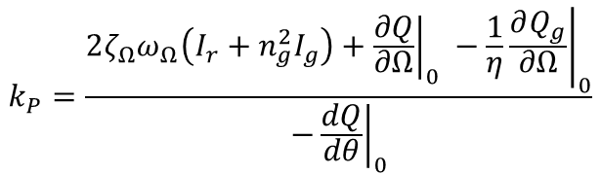
Region 3: Answer
See ‘derivation.pdf’
$$k_{P}=\frac{2ζ_{Ω}ω_{Ω}\left(I_{r}+n_{g}^{2}I_{g}\right)+{\left.\frac{∂Q}{∂Ω}\right|}_{0} −\frac{1}{η}{\left.\frac{∂Q_{g}}{∂Ω}\right|}_{0}}{−{\left.\frac{dQ}{dθ}\right|}_{0}}$$
$$k_{I}=\frac{ω_{Ω}^{2}\left(I_{r}+n_{g}^{2}I_{g}\right)}{−{\left.\frac{∂Q}{∂θ}\right|}_{0}}$$
Sometimes, we assume $\frac{∂Q}{∂Ω}{\left.​\right|}_{op}$ = 0 negligible

Slide 23
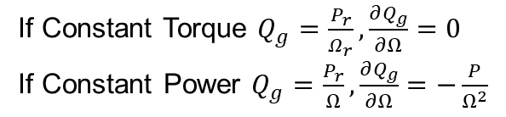

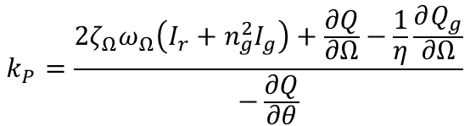

Region 3: Aerodynamic gain scheduling
We need to maintain the closed-loop speed mode at the desired behaviour ($ω_{Ω},ζ_{Ω}$)
However, some variables changes upon the operating point (wind speed, rotor speed, pitch angle)
How to modify our control law to ensure the desired behaviour of the closed-loop?
This is Disturbance,
$$\left(I_{r}+n_{g}^{2}I_{g}\right)\ddot{φ}+\left(\frac{1}{η}\frac{∂Q_{g}}{∂Ω}−\frac{∂Q}{∂Ω}−\frac{∂Q}{∂θ}k_{P}\right)\dot{φ}−\frac{∂Q}{∂θ}k_{I}φ=\frac{dQ}{dV}Δv$$
mass
damping
stiffness
External force
If Constant Torque $Q_{g}=\frac{P_{r}}{Ω_{r}}, \frac{∂Q_{g}}{∂Ω}=0$ If Constant Power $Q_{g}=\frac{P_{r}}{Ω}, \frac{∂Q_{g}}{∂Ω}=−\frac{P}{Ω^{2}}$
$$k_{P}=\frac{2ζ_{Ω}ω_{Ω}\left(I_{r}+n_{g}^{2}I_{g}\right)+\frac{∂Q}{∂Ω}−\frac{1}{η}\frac{∂Q_{g}}{∂Ω}}{−\frac{∂Q}{∂θ}}$$
Cancel out
$$k_{I}=\frac{ω_{Ω}^{2}\left(I_{r}+n_{g}^{2}I_{g}\right)}{−\frac{∂Q}{∂θ}}$$
How do we know these values

Slide 24
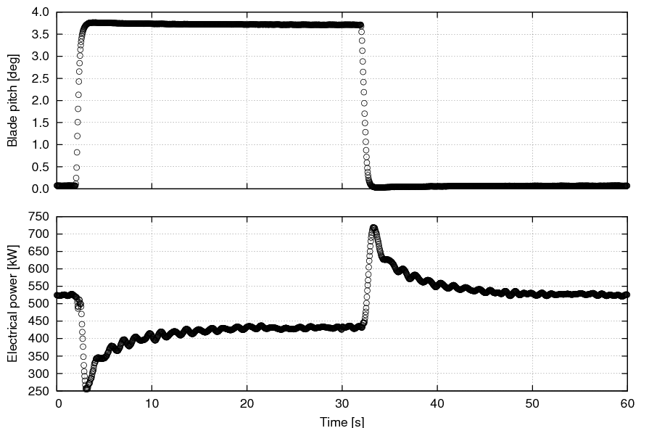
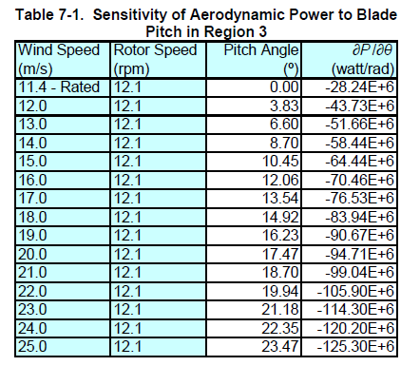
How to get aerodynamic gain? Method 1
When you have access to a real turbine …
$≈$3.7 deg
$\frac{∂Q}{∂θ}$ = aerodynamic gain
$≈$-32 kNm/deg
Measurement from Tjæreborg turbine by Øye (1991) at rated speed of 22 rpm
$≈$ -275 kW
$\frac{∂Q}{∂θ}$ $≈$-12 kNm/deg
Notes:
Frozen wake vs steady-state gradient
Axial induction factor is frozen before reaching to a new equilibrium. This is known as dynamic inflow.

Slide 25




How to get aerodynamic gain? Method 3
When you can only do simulation…
We need to calculate the steady state pitch angle
Applying a step wind (time simulation)
in aeroelastic code (BEM, HAWCStab2, FAST), changing the pitch until the power (aeroTorque) is reached rated.
For each pitch angle , calculate $Q$ and $Q_{ε}$ at steady state
Now,
Repeat for next pitch
$$Q=\frac{1}{2}ρAv^{3}C_{p}\left(λ,θ\right)Ω_{r}^{−1}$$
$$Q_{ε}=\frac{1}{2}ρAv^{3}C_{p}\left(λ,θ+ε\right)Ω_{r}^{−1}$$
$$\frac{∂Q}{∂θ}=\frac{Q−Q_{ε}}{ε}$$
Notes:
Steady state gradient, NOT frozen-wake gradient
Since we don’t have a dynamic inflow model

Slide 26

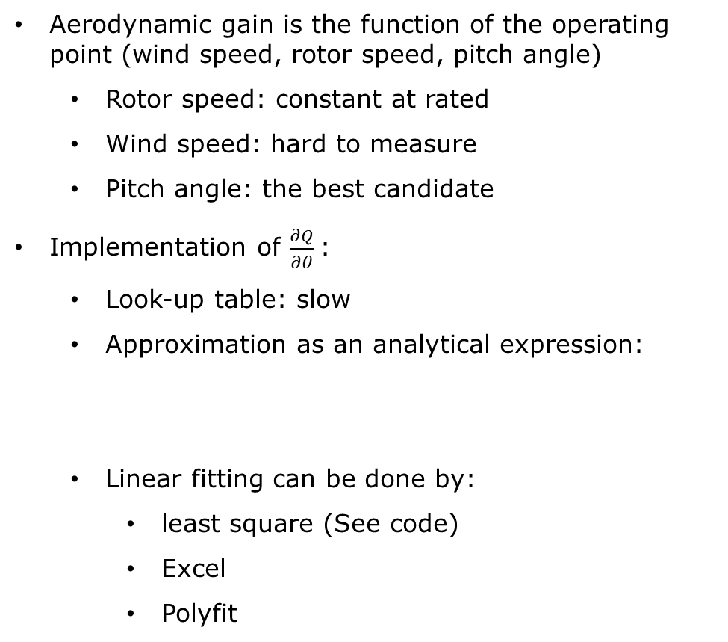
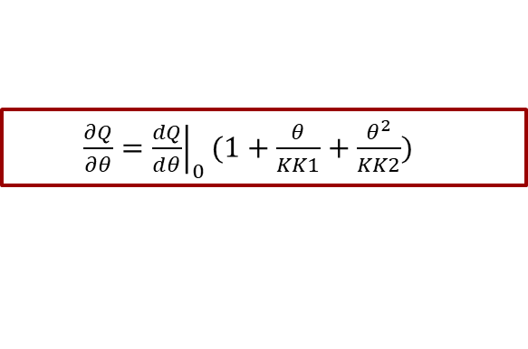


Aerodynamic gain scheduling
$$k_{P}=\frac{2ζ_{Ω}ω_{Ω}\left(I_{r}+n_{g}^{2}I_{g}\right)+\frac{∂Q}{∂Ω}−\frac{1}{η}\frac{∂Q_{g}}{∂Ω}}{−\frac{∂Q}{∂θ}}$$
$$k_{I}=\frac{ω_{Ω}^{2}\left(I_{r}+n_{g}^{2}I_{g}\right)}{−\frac{∂Q}{∂θ}}$$
Aerodynamic gain is the function of the operating point (wind speed, rotor speed, pitch angle)
Rotor speed: constant at rated
Wind speed: hard to measure
Pitch angle: the best candidate
Implementation of $\frac{∂Q}{∂θ}$:
Look-up table: slow
Approximation as an analytical expression:
Linear fitting can be done by:
least square (See code)
Excel
Polyfit
$\frac{∂Q}{∂θ}={\left.\frac{dQ}{dθ}\right|}_{0}(1+\frac{θ}{KK1}+\frac{θ^{2}}{KK2})$
$KK1$:Coefficient of linear term in aerodynamic gain scheduling [deg]
$KK2$: Coefficient of quadratic term in aerodynamic gain scheduling [deg^2]

Slide 27
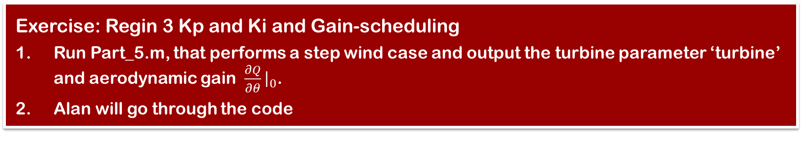
Region 3: Gain-scheduling exercise
Now, let’s derive the aerodynamic gain from a Cp table
Exercise: Regin 3 Kp and Ki and Gain-scheduling
Run Part_5.m, that performs a step wind case and output the turbine parameter ‘turbine’ and aerodynamic gain $\frac{∂Q}{∂θ}{\left.​\right|}_{0}$.
Alan will go through the code
Notes:
(1) Random guess of initial Kp and Ki that ensures convergence

Slide 28
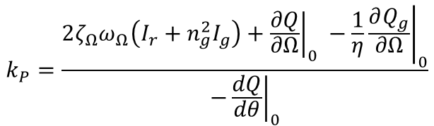
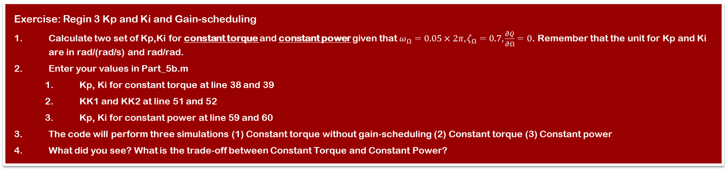
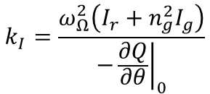
Region 3: Gain-scheduling exercise
$$k_{P}=\frac{2ζ_{Ω}ω_{Ω}\left(I_{r}+n_{g}^{2}I_{g}\right)+{\left.\frac{∂Q}{∂Ω}\right|}_{0} −\frac{1}{η}{\left.\frac{∂Q_{g}}{∂Ω}\right|}_{0}}{−{\left.\frac{dQ}{dθ}\right|}_{0}}$$
Now you have the aerodynamic gain and turbine parameters
turbine.J: 1.5710e+08
turbine. Prated: 10000000
controller.ratedOmega: 1.0050
dQdtheta0: -2.4006e+05
KK1: 1.9835
KK2: 128.8205
$$k_{I}=\frac{ω_{Ω}^{2}\left(I_{r}+n_{g}^{2}I_{g}\right)}{−{\left.\frac{∂Q}{∂θ}\right|}_{0}}$$
Exercise: Regin 3 Kp and Ki and Gain-scheduling
Calculate two set of Kp,Ki for constant torque and constant power given that $ω_{Ω}=0.05×2π,ζ_{Ω}=0.7, \frac{∂Q}{∂Ω}=0$. Remember that the unit for Kp and Ki are in rad/(rad/s) and rad/rad.
Enter your values in Part_5b.m
Kp, Ki for constant torque at line 38 and 39
KK1 and KK2 at line 51 and 52
Kp, Ki for constant power at line 59 and 60
The code will perform three simulations (1) Constant torque without gain-scheduling (2) Constant torque (3) Constant power
What did you see? What is the trade-off between Constant Torque and Constant Power?

Slide 29
Region 3: Answer
Constant Torque
Kp3 = 5.0235
Ki3 = 1.1273
Constant Power
Kp3 = 5.7433
Ki3 = 1.1273
Notes:
Instability if we didn’t use GS
Rotor speed similar, expected. The desired response with respect to the tuning omega and zeta
Constant power better at regulating power, however higher tower loads and more genTorq action

Slide 30
Region 3: Summary
1. Pitch angle is determined from PI controller
2. Generator torque is either a constant (P_{r}/Ω_{r}) or to P_{r}/Ω

Slide 31
Summary
By now we should be able to:
Tune a torque PI controller in Region 2.5
Tune a pitch PI controller in Region 3
Explain how the aerodynamic gain can be calculated
Understand how gain scheduling works for Region 3

